Slide 1

Lasso Regression
P. Tarun

Slide 2
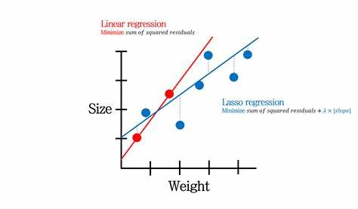
What is Lasso Regression?
Lasso regression is a regularization technique. It is used over regression methods for a more accurate prediction. This model uses shrinkage. Shrinkage is where data values are shrunk towards a central point as the mean. The lasso procedure encourages simple, sparse models (i.e. models with fewer parameters). This particular type of regression is well-suited for models showing high levels of multicollinearity or when you want to automate certain parts of model selection, like variable selection/parameter elimination.
Lasso Regression uses L1 regularization technique . It is used when we have more features because it automatically performs feature selection.

Slide 3
Lasso regression is a linear regression method that applies L1 regularization to the model. This regularization technique adds a penalty term to the ordinary least squares (OLS) cost function, which encourages the model to use fewer features in the final prediction.
Research on lasso regression has shown that it is particularly useful for high-dimensional datasets, where the number of features is much larger than the number of observations. Lasso can effectively identify and remove irrelevant or redundant features, leading to better model performance and interpretability. Additionally, lasso has been shown to outperform other regularization techniques, such as ridge regression, in cases where only a subset of the features have a significant impact on the response variable.
Lasso has also been used in a variety of fields, including finance, engineering, and medicine. Some common applications include feature selection in high-dimensional datasets, prediction of stock prices, and identifying biomarkers for disease diagnosis.

Slide 4

Pseudo Code for Lasso Regression
Start by importing necessary libraries and data set.
Preprocess data (clean, encode, scale).
Split the data into training and testing sets.
Define the alpha values to be used in Lasso Regression.
Loop through the alpha values.
Fit the model using the training data.
Predict the response variable using the testing data.
Evaluate the performance of the model using metrics such as mean squared error or R-squared.
Select the best alpha value based on the performance metrics.
Fit the final model using the best alpha value and the entire data set.
Use the final model to make predictions on new data.

Slide 5
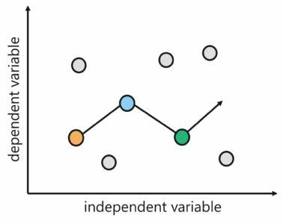
Linear Regression Vs Lasso Regression
Linear regression and Lasso regression are both statistical methods used for modeling the relationship between a dependent variable and one or more independent variables, but they differ in their approach to model fitting and variable selection.
Linear regression aims to minimize the sum of squared residuals to find the best-fit line that describes the relationship between the variables. It assumes that all independent variables have a linear relationship with the dependent variable and that they all contribute equally to the model.
Lasso regression, on the other hand, adds a penalty term to the sum of squared residuals that is proportional to the absolute values of the regression coefficients.
This penalty term shrinks the coefficient estimates towards zero, effectively eliminating some of the independent variables that have little or no predictive power.

Slide 6
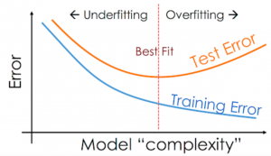
Overfitting
Overfitting occurs when a model is too complex and is trained to fit the training data too closely.
This means that the model may perform very well on the training data, but it may not generalize well to new data.
Overfitting is often a result of having too many features or parameters, or not having enough data to properly train the model.
Overfitting can be detected by observing that the model has a high training accuracy, but a low test accuracy.

Slide 7
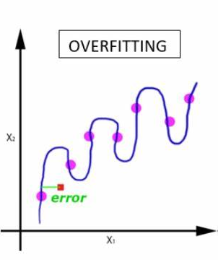
Over fitting Control Methods
Overfitting is a common problem in machine learning where a model fits the training data too closely and performs poorly on new data. To control overfitting, we can use the following methods:
Cross-validation: Cross-validation is a method of dividing the data into multiple training and testing sets, allowing the model to be tested on multiple data subsets. This helps in identifying whether the model is overfitting to a particular training set.
Regularization: Regularization is a technique used to control the complexity of the model by adding a penalty term to the cost function. The penalty term adds a cost for large coefficients, which helps in reducing overfitting by keeping the model weights small.
Dropout: Dropout is a technique used to randomly drop out nodes from the neural network during training. This helps in reducing overfitting by preventing the network from relying too much on any particular node or set of nodes.
Reduce model complexity: Overfitting can be caused by having too many features or parameters in the model.

Slide 8
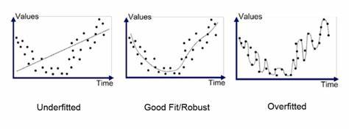
Underfitting
Underfitting of machine learning models happens when you are not able to reduce the training error. This can happen in some of the following scenarios:
When the training set has far fewer observations than variables, this may lead to underfitting or low bias machine learning models. In such cases, the machine learning models cannot find any relationship between input data and the response variable because the model is not complex enough to model the data.
When machine learning algorithm cannot find any pattern between training and testing set variables which may happen in the high-dimensional dataset or a large number of input variables. This could be due to insufficient machine learning model complexity, limited available training observations for learning patterns, limited computing power that limits machine learning algorithms’ ability to search for patterns in high dimensional space

Slide 9
Underfitting Control Methods
Underfitting occurs when a model is too simple and is not able to capture the underlying patterns in the data. To control underfitting, the following methods can be used:
Increase the complexity of the model: One of the simplest ways to control underfitting is to increase the complexity of the model. This can be done by adding more layers or nodes to the neural network, or by increasing the number of features in the dataset.
Feature engineering: Feature engineering is the process of creating new features from existing features. This can be done by combining features, transforming features, or creating new features. Feature engineering can help the model to capture the underlying patterns in the data.
Increase the amount of training data: Underfitting can occur if the amount of training data is not sufficient. Increasing the amount of training data can help the model to capture more of the underlying patterns in the data.
Reduce bias: Bias is the difference between the true value and the predicted value. If the model has high bias, it means that the model is not able to capture the underlying patterns in the data.

Slide 10
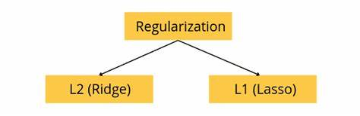
Regularization
Regularization is an important concept that is used to avoid overfitting of the data, especially when the trained and test data are much varying.
Regularization is implemented by adding a “penalty” term to the best fit derived from the trained data, to achieve a lesser variance with the tested data and also restricts the influence of predictor variables over the output variable by compressing their coefficients.
In regularization, what we do is normally we keep the same number of features but reduce the magnitude of the coefficients. We can reduce the magnitude of the coefficients by using different types of regression techniques which uses regularization to overcome this problem.

Slide 11
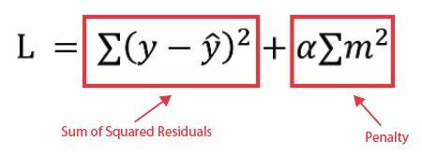
L1 Regularization
Lasso regression performs L1 regularization, which adds a penalty equal to the absolute value of the magnitude of coefficients. This type of regularization can result in sparse models with few coefficients; Some coefficients can become zero and eliminated from the model. Larger penalties result in coefficient values closer to zero, which is the ideal for producing simpler models.
On the other hand, L2 regularization (e.g. Ridge regression) doesn’t result in elimination of coefficients or sparse models. This makes the Lasso far easier to interpret than the Ridge.

Slide 12
Penalty Function in Lasso Regression
In Lasso (Least Absolute Shrinkage and Selection Operator) regression, a penalty function is added to the cost function to avoid overfitting and encourage feature selection. The penalty function is a term added to the sum of squared errors (SSE) that represents the magnitude of the coefficients of the regression equation.
The penalty function for Lasso regression is given by the absolute sum of the coefficients (L1 regularization):
Lasso Penalty = λ * ∑|βi|
where βi represents the coefficients in the regression equation, and λ is a tuning parameter that controls the strength of the penalty.
By adding the penalty term, Lasso regression encourages sparse solutions, where only a subset of the features has non-zero coefficients. This can lead to better generalization performance, as it helps to reduce the variance in the model.

Slide 13

Performing the Lasso Regression
Lasso solutions are quadratic programming problems, which are best solved with software (like Matlab ). The goal of the algorithm is to minimize
Which is the same as minimizing the sum of squares with constraint Σ |B_{j}≤ s (Σ = summation notation ). Some of the βs are shrunk to exactly zero, resulting in a regression model that’s easier to interpret.
A tuning parameter , λ controls the strength of the L1 penalty. λ is basically the amount of shrinkage
When λ = 0, no parameters are eliminated. The estimate is equal to the one found with linear regression.
As λ increases, more and more coefficients are set to zero and eliminated (theoretically, when λ = ∞, all coefficients are eliminated).
As λ increases, bias increases.

Slide 14
Hyperparameters in Lasso Regression
Hyperparameters in Lasso regression refer to the parameters that control the behavior of the model during training. These parameters are not learned from the data but are set manually before training the model. The main hyperparameter in Lasso regression is the regularization parameter (often denoted by λ). This parameter controls the strength of the regularization applied to the model.
Regularization is a technique used to prevent overfitting in machine learning models. Lasso regression uses L1 regularization, which involves adding a penalty term to the cost function that is proportional to the absolute value of the model coefficients.
This penalty term shrinks the coefficients towards zero and can result in a sparse model with only a few non-zero coefficients.
The value of the regularization parameter determines the degree of shrinkage applied to the model coefficients. A higher value of λ leads to more shrinkage and a sparser model, while a lower value of λ allows more flexibility in the model and can result in overfitting. Therefore, the regularization parameter is a critical hyperparameter that needs to be tuned carefully to obtain a good model.

Slide 15

Mathematical equation of Lasso Regression
Residual Sum of Squares + λ * (Sum of the absolute value of the magnitude of coefficients)
Where,
λ denotes the amount of shrinkage.
λ = 0 implies all features are considered and it is equivalent to the linear regression where only the residual sum of squares is considered to build a predictive model
λ = ∞ implies no feature is considered i.e, as λ closes to infinity it eliminates more and more features
The bias increases with increase in λ
variance increases with decrease in λ

Slide 16
Implementation of Lasso Regression
Lasso regression can be implemented using various programming languages and machine learning libraries. Here's an example implementation using Python and scikit-learn:
In this implementation, we first load the dataset and split it into training and testing sets. We then create a Lasso regression object with a regularization parameter of 0.01.
We train the Lasso regression model on the training data using the fit() method, and evaluate the model on the testing data using the predict() method.
Finally, we calculate the mean squared error and R-squared score to assess the performance of the model.
Note that in practice, you may need to tune the regularization parameter to find the optimal value for your specific problem.

Slide 17
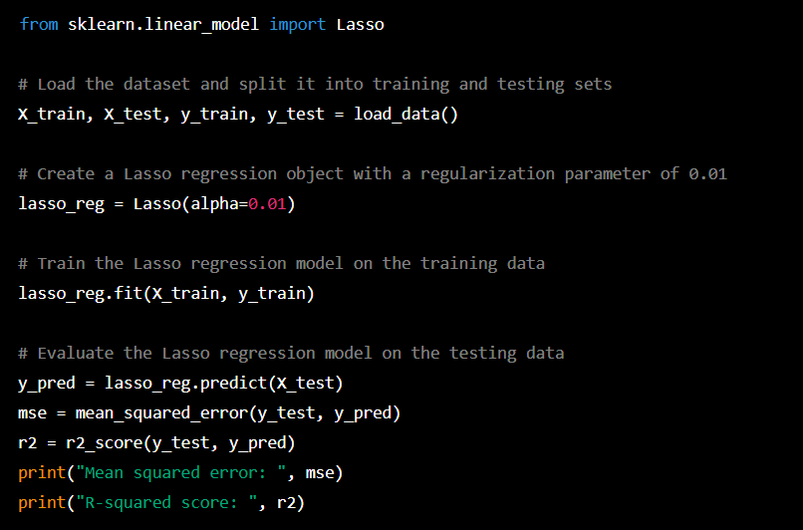

Slide 18
Advantages of Lasso Regression
Lasso regression is a popular technique for feature selection and regularization in linear regression. It has several advantages, including:
Feature selection: Lasso regression can automatically perform feature selection by shrinking the coefficients of less important features to zero. This helps in identifying the most important features for prediction.
Reducing overfitting: Lasso regression adds a penalty term to the cost function that limits the complexity of the model and prevents overfitting. This improves the generalization performance of the model and reduces the variance.
Interpretability: The L1 penalty in Lasso regression encourages sparsity in the model, which means that only a subset of features have non-zero coefficients. This makes the model more interpretable and easier to understand.

Slide 19
Works well with high-dimensional data: Lasso regression is particularly useful when dealing with high-dimensional data, where the number of features is much larger than the number of observations. In such cases, Lasso regression can select a subset of important features and produce a simpler and more interpretable model.
Can handle correlated predictors: Lasso regression performs well when dealing with highly correlated predictors, which can be problematic for other regression techniques like ridge regression. This is because Lasso regression can select one of the correlated features and shrink the coefficients of the others to zero.
Overall, Lasso regression is a powerful technique that can improve the performance and interpretability of linear regression models, especially in cases where feature selection and regularization are important.

Slide 20
Disadvantages of Lasso Regression
Lasso regression is a type of linear regression that uses L1 regularization to promote sparsity in the model, meaning that it encourages some of the coefficients to be exactly zero. While lasso regression has some advantages, there are also some potential disadvantages to using this method:
Feature selection bias: Lasso regression tends to select a subset of features that are most important for predicting the target variable, and can completely exclude other features that may also be relevant. This can be a disadvantage if there are other important features that are not included in the model.
Instability: Lasso regression can be unstable when there is high correlation between predictors. This can result in some coefficients being overly emphasized or de-emphasized, leading to less accurate predictions.
Tuning parameter selection: Lasso regression requires the selection of a tuning parameter, which determines the strength of the regularization penalty. Choosing the optimal tuning parameter can be difficult, and a poor choice can result in underfitting or overfitting the data.

Slide 21
Bias towards small effect sizes: Lasso regression tends to shrink the coefficients of predictors towards zero, which can be problematic if there are important predictors with small effect sizes. In some cases, this can lead to an underestimation of the true effects.
Model complexity: While lasso regression can lead to a simpler model with fewer predictors, this may not always be desirable. In some cases, a more complex model with more predictors may be necessary to capture the true underlying relationships between the predictors and the target variable.

Slide 22


